Slide 1


Deception as a Successful Deterrent of Aggression Action: Game Theory Approach to Wargaming
Sophia Rose Calof Lander
University of Texas at Austin, Department of Government
ISMOR 42
July 2025

Slide 2
Central Dilemma
Wargaming falters on its non-replicability, non-generalizability, and labor-intensive process
Binary relationship in wargaming between brute force action and deception
Dealing with random chance or surprise in wargaming
1
2
3
Notes:
Mention to the limited aspects of AI:
AI mentioned easily a hundred times in today, game theory mentioned once, and modifying human intelligence (i.e., how we think about problems differently, unassisted by data or computers) mentioned equally less

Slide 3
RESEARCH QUESTION
GAPS IN LITERATURE
HYPOTHESIS
RESEARCH DESIGN
+
GAME THEORY MODEL
CASE STUDY RESULTS
SIMULATION RESULTS
ANALYSIS AND CONCLUSIONS

Slide 4
Gaps in Literature
Game theory approaches to deception struggle to operationalize their findings
  Davis et al. 2016 and Sokri 2021
Assume benefit to blue team actors
Focus on specific deceptive actions instead of general approaches
Deception as a counter plan
  i.e., deception decreases costs to deterrence not increases payoff
Can we create a game that models general deceptive practices as a positive deterrent to aggressive action for both red and blue team?

Slide 5
RESEARCH QUESTION
GAPS IN LITERATURE
HYPOTHESIS
RESEARCH DESIGN
+
GAME THEORY MODEL
CASE STUDY RESULTS
SIMULATION RESULTS
ANALYSIS AND CONCLUSIONS

Slide 6
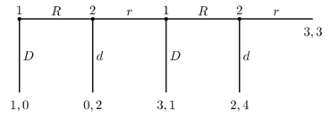
What is game theory?
Study of the ways interacting choices of actors produce outcomes
  Each actor makes decisions with respect to preferences and utilities (payoffs)
  Outcomes of games do not have to be intended by any actor*
Ex. Centipede game
Goal: understand decisions that have costs/benefits
  Introduces quantitative and replicable results
*Adapted from the Stanford Encyclopedia of Philosophy
Notes:
With the Prisoner’s dilemma: what’s valuable about game theory is it can illustrate to us when sometimes outcomes of the game have unintended consequences for all players even if the choices that lead to them are optimal for each individual player

Slide 7
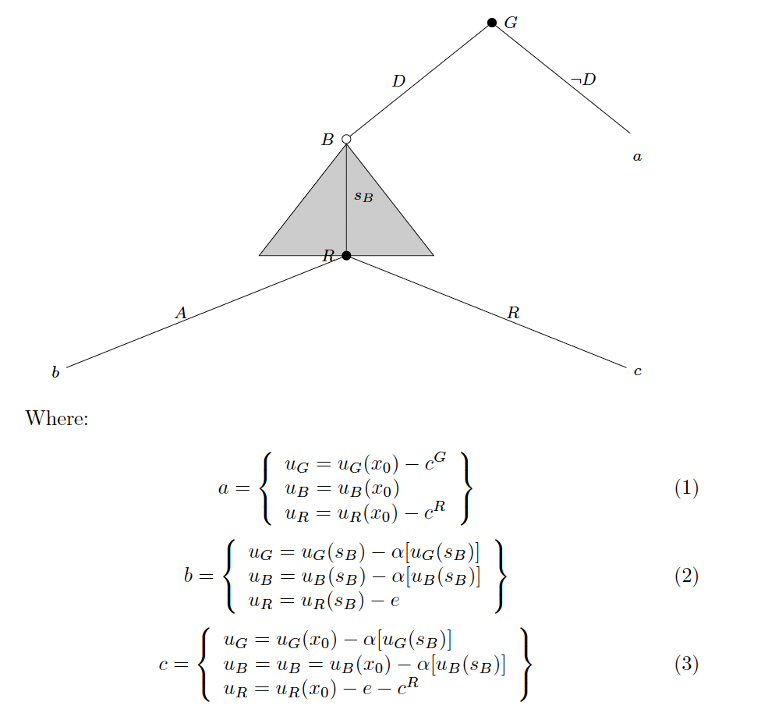
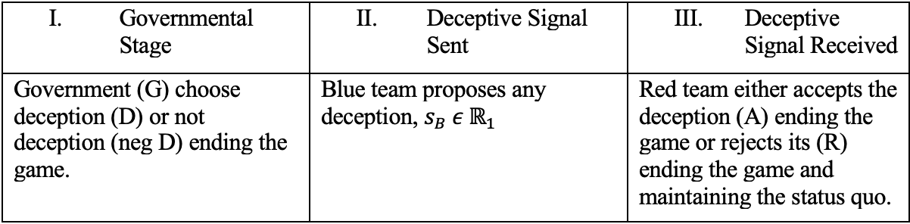

Figure 1
Model Assumptions and Utility Determination (where $i=G,B,R$)
Signal payoff, $u_{i}(x_{0} \text{or} s_{B})$
Cost of sending a signal, $α[u_{i}\left(s_{B}\right)]$
Cost of risk associated with accepting any signal, $e$
Cost of taking aggressive action, $c^{i}$
Assumptions
- $α≥0$
- $e (+/−$)
- $c^{i}≥0$
- $x_{0}≤s_{B}$

Slide 8
Figure 2
Equilibrium Paths
1
2
What is an equilibrium?
- a path in which all players simultaneously are playing their best strategies (i.e., the strategies that yield the highest possible utility)
Path 1
a > b > c
Path 2
b > c > a
For all players
How do we solve?
Backwards induction
Verify that every player is playing a best strategy

Slide 10
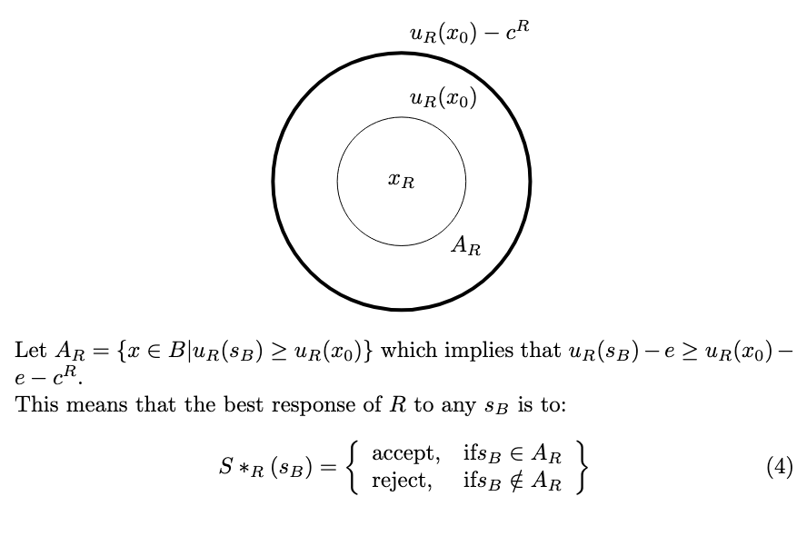
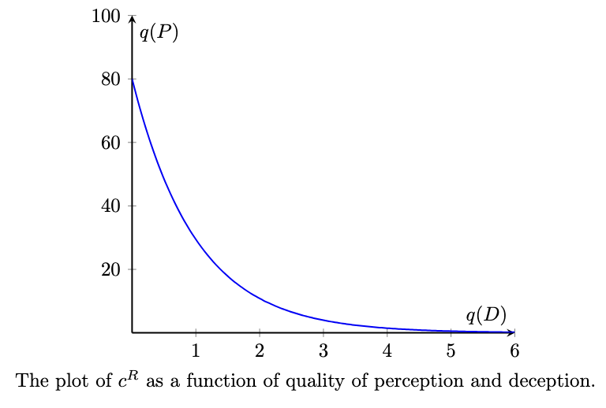
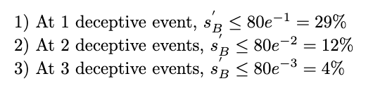

What is the set of signals, $s_{B}$, that R will accept?
Figure 3
Figure 4
*we will return to this
Notes:
If I’m China then I think q(P) is like this. Etc.

Slide 12
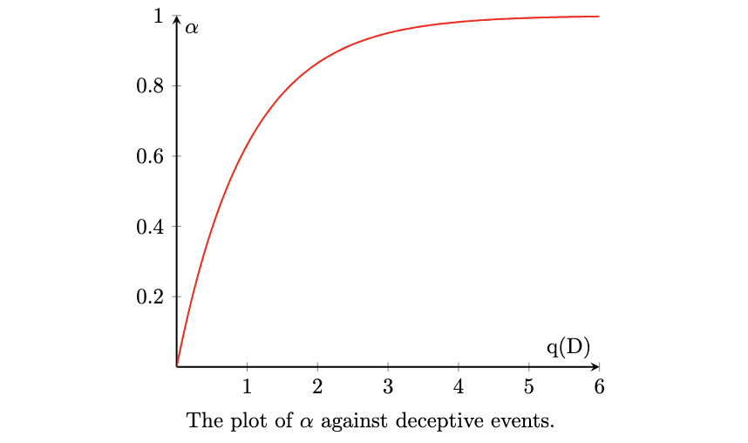
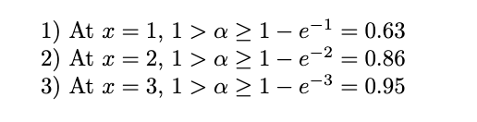


What is the set of signals, $s_{B}$, that is optimal for B to send?
Figure 5
We are concerned with the case when payoff from a deception is greater than the costs of implementing it:
$$u_{B}\left(s_{B}\right)≥α[u_{B}\left(s_{B}\right)]$$
We can express this as a function of the number of deceptions:
$$y=1−e^{−x}$$

Slide 14
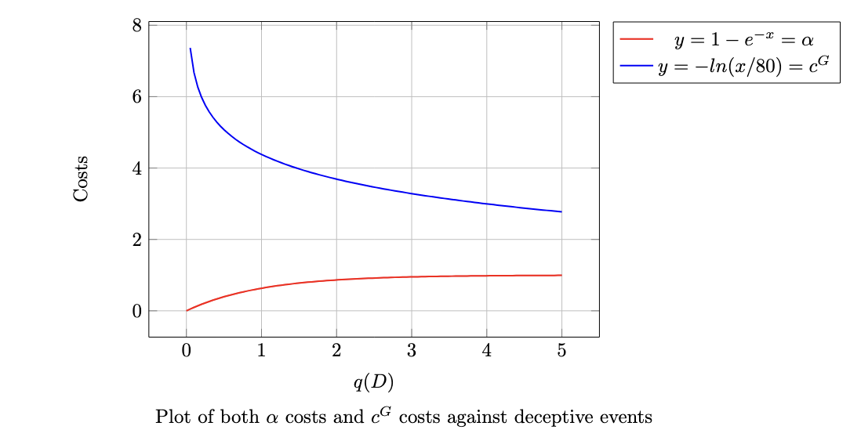


What is the set of signals, $s_{B}$, that is optimal for G to execute?
ALL OF THEM
We want to ensure that the costs of a deception never outweigh the costs of taking brute force aggressive action:
$$α[u_{B}\left(s_{B}\right)]≤c^{G}$$
We can express $c^{G}$ as the inverse function of $c^{R}:$
$$y=−\ln{\frac{x}{80}}$$

Slide 15
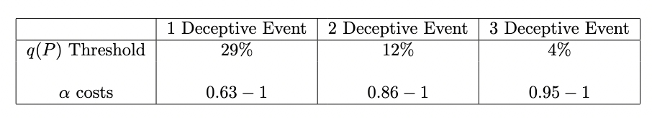
Equilibrium Results
Figure 6
What do we learn under these conditions?
There is a ”deceptive space” in which it is OPTIMAL for red team to accept the deception as truth
  Maybe it is believed as truth, but it doesn’t matter
A deception is always OPTIMAL over brute force aggression for blue team

Slide 16
RESEARCH QUESTION
GAPS IN LITERATURE
HYPOTHESIS
RESEARCH DESIGN
+
GAME THEORY MODEL
CASE STUDY RESULTS
SIMULATION RESULTS
ANALYSIS AND CONCLUSIONS

Slide 17

Operation Desert Storm as a Case Study
How do we operationalize the model variables?
1) $q\left(P\right)$
2) $q\left(D\right)$
3) $α \text{costs}$
Marine Corps Deception Manual
An increase or decrease in preparation of defensive positions (implying a period of static activity).
An increase or decrease in adversary intelligence collection in the vicinity of our main axis of advance at the expense of other sectors (is the adversary indicating an interest?).
An increase or decrease in route reconnaissance toward the friendly sector by armored reserve units or leadership (is this pending or an active branch plan?).
An increase or decrease in battle drill or movement rehearsal by the adversary reserve.
Forces moved towards Kuwait border -25%
Goal: reinforcing Iraqi belief that U.S. forces would mainly attack Kuwait
Adversary increased intelligence collection of deceptive material -25%
Marine Corps Deception Manual
Administrative costs
Technical costs
Personnel costs
Forces around Baghdad remained constant,
-25%
Increased battle drill behavior around Baghdad +25%

Slide 18
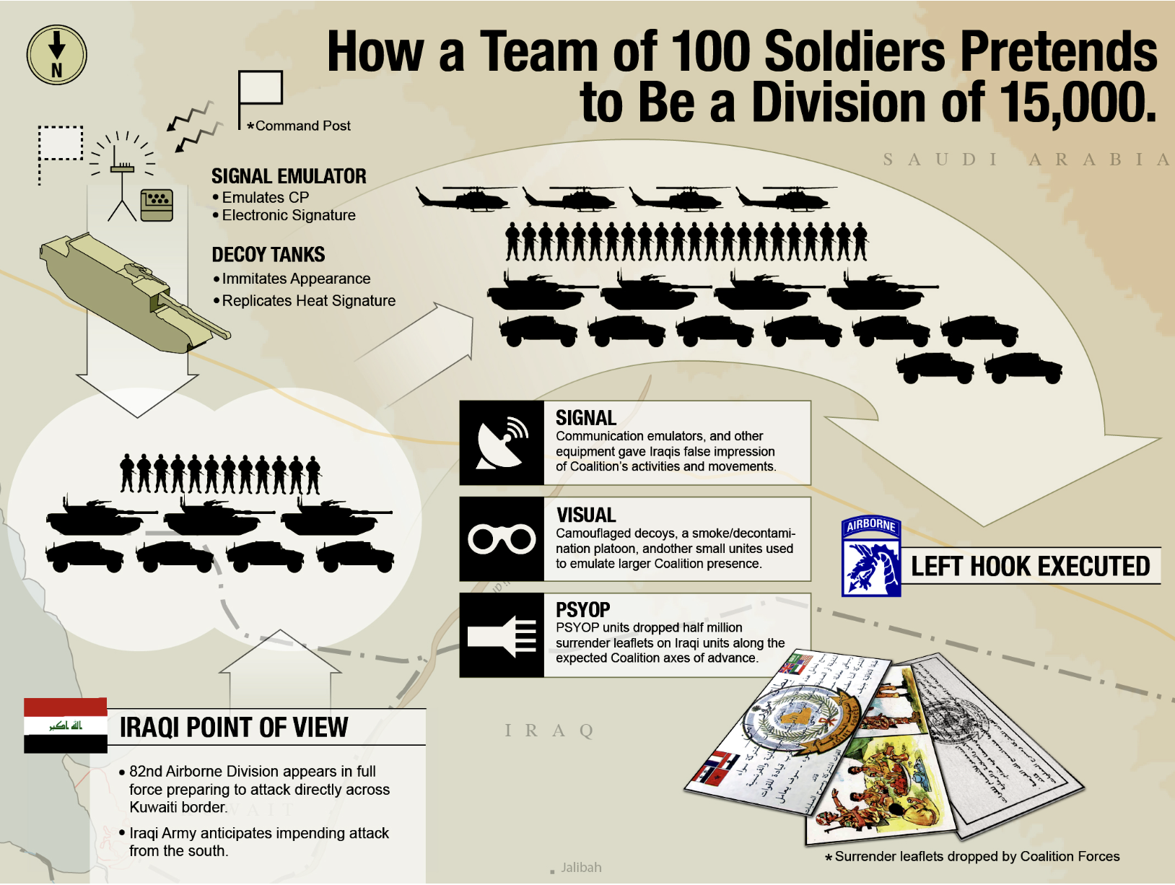




Costs have to be proportional to personnel:
$\frac{{300}^{2}}{650,000}=1.38\%$
$$α=0.40$$
Technical costs are related to tanks
$$α=0.20$$
Administrative costs
$$α=0$$
TOTAL = 0.60
*Graphic taken from Wright 2018

Slide 19
RESEARCH QUESTION
GAPS IN LITERATURE
HYPOTHESIS
RESEARCH DESIGN
+
GAME THEORY MODEL
CASE STUDY RESULTS
SIMULATION RESULTS
ANALYSIS AND CONCLUSIONS

Slide 20
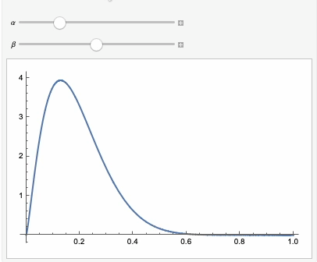
Simulations
Solve generalizability and specificity problems of wargaming
Monte Carlo Simulations
  Use repeated random samples to test possible outcomes of an uncertain event
Figure 7
Repeated random sample
Run over 1000 iterations
Beta distribution
Our uncertain event
the acceptance of a deception by red team

Slide 21
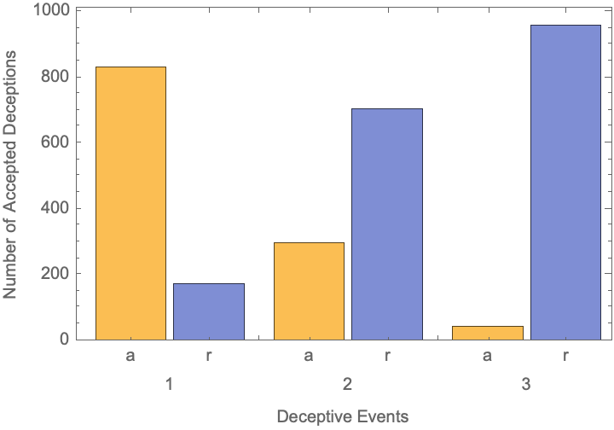
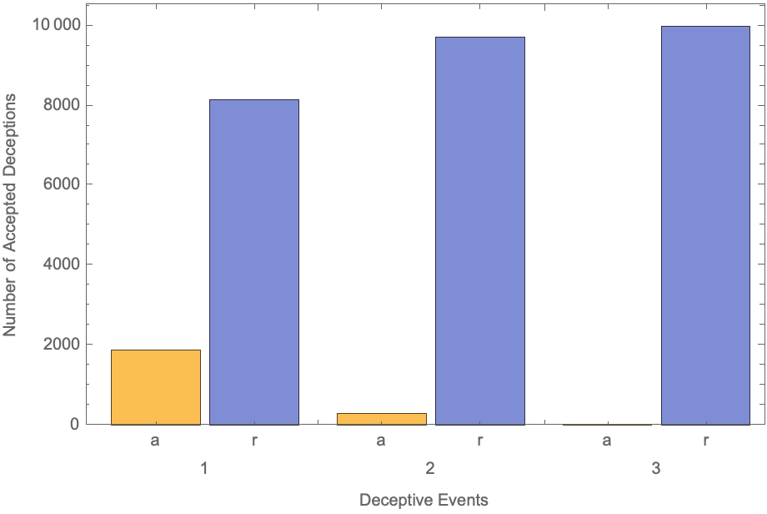



Results
We can mess with the tails of the beta distribution to get different results:
*Essentially, we are changing the magnitude of $c^{R}$ and scope of $A_{R}$
Figure 8
Figure 9
$α=2.33$, $β=10$
$α=2.33$, $β=2.33$
(almost normal distribution)

Slide 22
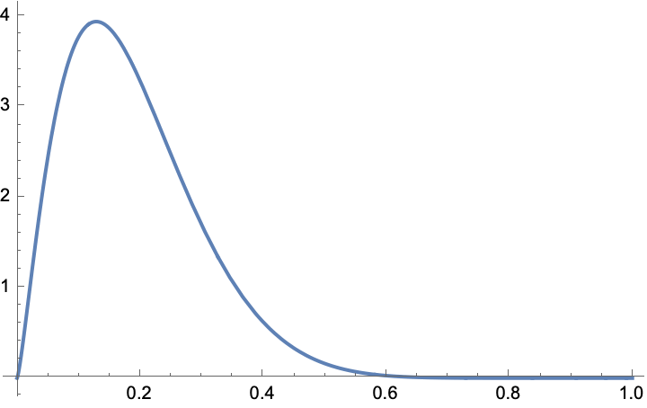
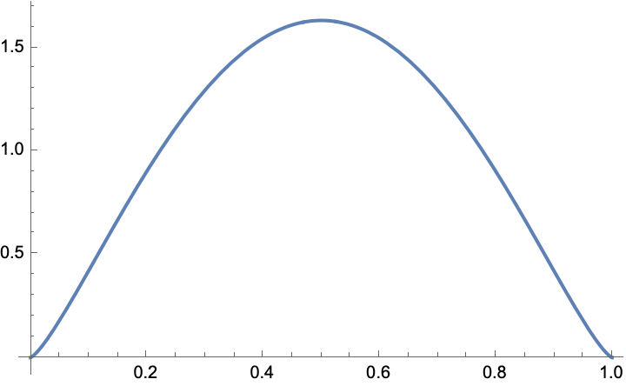



Beta distributions → magnitude of $A_{R}$ as q(P) changes
$α=2.33$, $β=10$
$α=2.33$, $β=2.33$
Figure 10
Figure 11
As the distribution changes from beta → normal:
the likelihood of acceptance of deception decreases dramatically
Essentially, as blue team’s initial ideas about red team’s q(P) decrease, so too does our ability to create a successful deception

Slide 23
RESEARCH QUESTION
GAPS IN LITERATURE
HYPOTHESIS
RESEARCH DESIGN
+
GAME THEORY MODEL
CASE STUDY RESULTS
SIMULATION RESULTS
ANALYSIS AND CONCLUSIONS

Slide 24

What do we find?
1) There exists an operational deceptive space, $A_{R}$, in which all blue team’s deceptions will be accepted by red team
  Regardless of beliefs about validity
2) Under certain conditions, deception is optimal for all players
  Deterring aggressive action
3) Variations in blue team’s beliefs about red team’s quality of perception matter intensely to the game’s outcome

Slide 25
Implications & Further Research
Studying further psychological background for determining quality of perception
Find other case studies to operationalize the model further
But most importantly, DECEPTION WORKS

Slide 26

Thank you
Contact: Sophia Lander slander835@gmail.com
Acknowledgement: Kyle Libby, Head of Research at Metrea

